Slide 1
18CSC205J - OPERATING SYSTEMS
UNIT-1
Session-14,15
SLO 1,2-Understanding the various phases of compilation of a C program
SRM Institute of Science and Technology, Ramapuram

Slide 2
Understanding the various phases of compilation of a C program
Objective: To practice how to create and execute C Programs in Linux.
Compilation of C Program
Step 1: Open the terminal and edit your program using vi editor/gedit editor and save with extension ―.c
Ex. vi test.c (or) gedit text.c
Step 2: Compile your program using gcc compiler
Ex. gcc test.c -> Output file will be “a.out”
(or) gcc –o test text.c ->Output file will be “test”
Step 3: Correct the errors if any and run the program
Ex. ./a.out or ./test
SRM Institute of Science and Technology, Ramapuram

Slide 3
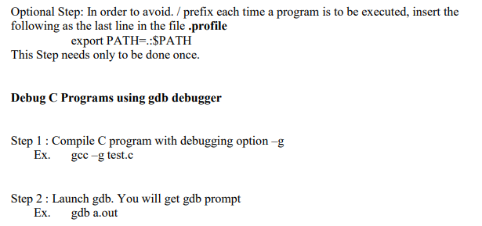
Understanding the various phases of compilation of a C program
SRM Institute of Science and Technology, Ramapuram

Slide 4
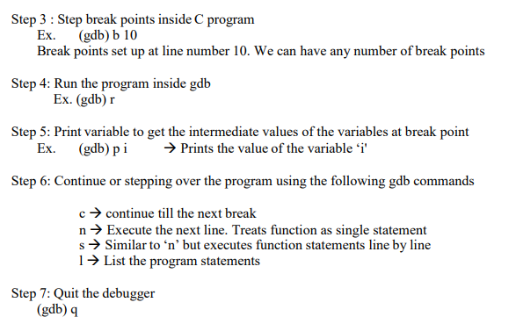
Understanding the various phases of compilation of a C program
Outcome: Learned and practiced how to create and execute C Programs in Linux
SRM Institute of Science and Technology, Ramapuram

